Slide 1



Noida Institute of Engineering and Technology, Greater Noida
Object Oriented Techniques Using Java
Unit: III
Packages, Exception Handling and String Handling
ADITEE MATTOO
Assistant Professor
IoT Department
3rd Semester
(AIML/IoT)

Slide 2
Contents
Course objective
Course outcome (CO)
CO – PO Mapping
CO – PSO Mapping
Prerequisites
Object Oriented Analysis
Functional Model
Domain Analysis
Application Analysis
Object Oriented Design
Breaking a system into subsystems-SD
Identify concurrency inherent in the problem
Management of Data Storage
Difference between JSD and OST
Implementing Encapsulation
Quiz
Previous year questions
References and links

Slide 3
Course Objective
At the end of the semester, the student will be able to:
Understand the functionality and basic concepts of object oriented design techniques.
Understand and apply various object oriented features like inheritance, data abstraction, encapsulation and polymorphism to solve various computing problems.
Appreciate the dynamic memory allocation functions, access specifiers and the friend functions.
Understanding the basics of C and C++.
Implementing the subprogram call and return.

Slide 4
Course Outcome
CO1: Identify the concepts of object-oriented programming and relationships among them needed in modeling.
CO2: Demonstrate the Java programs using OOP principles and also implement the concepts of lambda expressions.
CO3: Implement packages with different protection level resolving namespace collision and evaluate the error handling concepts for uninterrupted execution of Java program.
CO4: Implement Concurrency control, I/O Streams and Annotations concepts by using Java program.
CO5: Design and develop the GUI based application, Generics and Collections in Java programming language to solve the real-world problem.

Slide 5
Program Outcome
1. Engineering knowledge: Apply the knowledge of mathematics, science, engineering fundamentals, and an engineering specialization for the solution of complex engineering problems.
2. Problem analysis: Identify, formulate, research literature, and analyze complex engineering problems reaching substantiated conclusions using first principles of mathematics, natural sciences, and engineering sciences.
3. Design/development of solutions: Design solutions for complex engineering problems and design system components or processes that meet the specified needs with appropriate consideration for public health and safety, and cultural, societal, and environmental considerations.
4. Conduct investigations of complex problems: Use research based knowledge and research methods including design of experiments, analysis and interpretation of data, and synthesis of information to provide valid conclusions.
5. Modern tool usage: Create, select, and apply appropriate techniques, resources, and modern engineering and IT tools, including prediction and modeling to complex engineering activities, with an understanding of the limitations.

Slide 6
Program Outcome
6. The engineer and society: Apply reasoning informed by the contextual knowledge to assess societal, health, safety, legal and cultural issues and the consequent responsibilities relevant to the professional engineering practice.
7. Environment and sustainability: Understand the impact of the professional engineering solutions in societal and environmental contexts, and demonstrate the knowledge of, and need for sustainable development.
8. Ethics: Apply ethical principles and commit to professional ethics and responsibilities and norms of the engineering practice.
9. Individual and team work: Function effectively as an individual, and as a member or leader in diverse teams, and in multidisciplinary settings.
of technological change.

Slide 7
Program Outcome
10. Communication: Communicate effectively on complex engineering activities with the engineering community and with the society at large, such as, being able to comprehend and write effective reports and design documentation, make effective presentations, and give and receive clear instructions.
11. Project management and finance: Demonstrate knowledge and understanding of the engineering and management principles and apply these to one’s own work, as a member and leader in a team, to manage projects and in multidisciplinary environments.
12. Life-long learning: Recognize the need for, and have the preparation and ability to engage in independent and life-long learning in the broadest context

Slide 8
Program Specific Outcomes
On successful completion of graduation degree the Engineering
graduates will be able to:
PSO1:The ability to identify, analyze real world problems and design their ethical solutions using artificial intelligence, robotics, virtual/augmented reality, data analytics, block chain technology, and cloud computing.
PSO2:The ability to design and develop the hardware sensor devices and related interfacing software systems for solving complex engineering problems.
PSO3:The ability to understand inter disciplinary computing techniques and to apply them in the design of advanced computing.
PSO4: The ability to conduct investigation of complex problem with the help of technical, managerial, leadership qualities, and modern engineering tools provided by industry sponsored laboratories.

Slide 9
CO-PO Mapping
Mapping of Course Outcomes and Program Outcomes:
 | PO1 | PO2 | PO3 | PO4 | PO5 | PO6 | PO7 | PO8 | PO9 | PO10 | PO11 | PO12
CO.1 | 3 | 3 | 3 | 2 | 1 |  |  |  | 2 |  |  | 3
CO.2 | 3 | 3 | 3 | 2 | 1 |  |  |  | 2 |  |  | 3
CO.3 | 3 | 3 | 3 | 2 | 1 |  |  |  | 2 |  |  | 3
CO.4 | 3 | 3 | 3 | 2 | 1 |  |  |  | 2 |  |  | 3
CO.5 | 3 | 3 | 3 | 2 | 1 |  |  |  | 2 |  |  | 3
3= High, 2=Medium, 1=Low

Slide 10
CO- PSO Mapping
 | PSO1 | PSO2 | PSO3 | PSO4
Co.1 | 2 | 3 | 2 | 1
CO.2 | 2 | 3 | 2 | 1
CO.3 | 2 | 3 | 2 | 1
CO.4 | 2 | 3 | 2 | 1
CO.5 | 2 | 3 | 2 | 1
3= High, 2=Medium, 1=Low

Slide 11
Syllabus

Slide 12
Syllabus

Slide 13
Prerequisites
Student must know at least the basics of how to use a computer, and should be able to start a command line shell.
Knowledge of basic programming concepts, as covered in ‘Programming Basic” course is necessary
Students should have the basic understanding of object-oriented analysis and design along with its associated terminologies.
It is assumed that students have basic understanding of computer programming and related programming paradigms.

Slide 14
PACKAGES (CO3)
A package is a collection of similar types of Java entities such as classes, interfaces, subclasses, exceptions, errors, and enums.
A package can also contain sub-packages.
Packages are used for:
Preventing naming conflicts. For example there can be two classes with name Employee in two packages, college.staff.cse.Employee and college.staff.ee.Employee.
Making searching/locating and usage of classes, interfaces, enumerations and annotations easier.
Providing controlled access: protected and default have package level access control. A protected member is accessible by classes in the same package and its subclasses. A default member (without any access specifier) is accessible by classes in the same package only.
Packages can be considered as data encapsulation (or data-hiding).

Slide 15
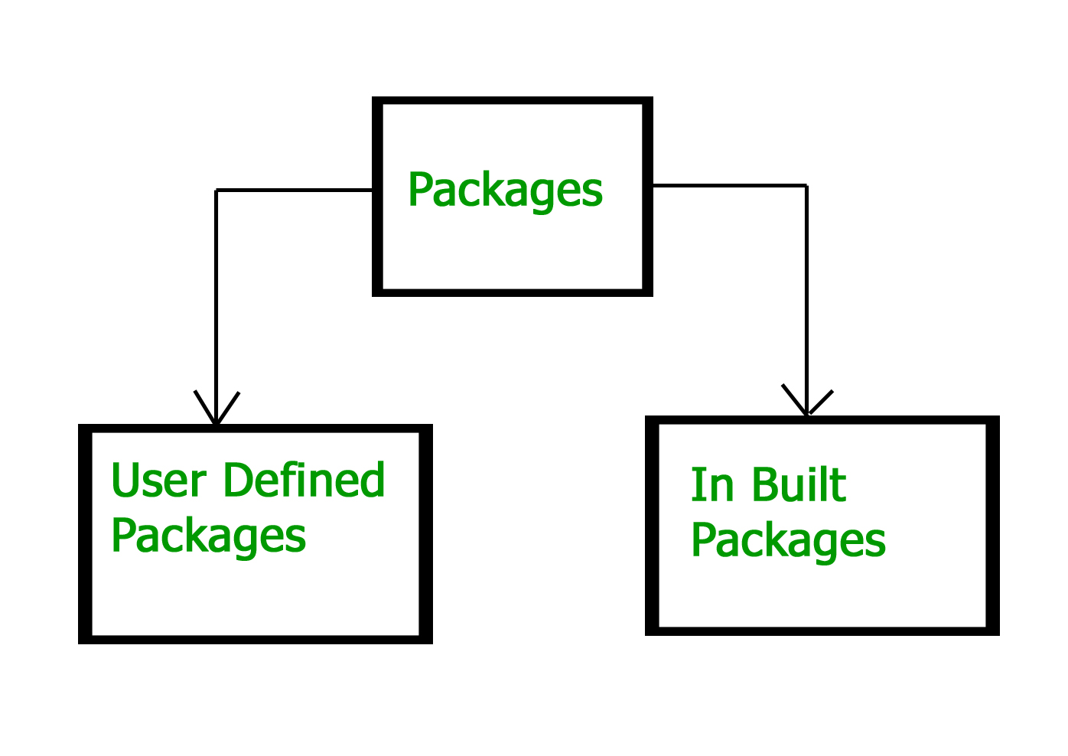
TYPES OF PACKAGES(CO3)
1. User-defined Package
The package which is defined by the user is called a User-defined package.
It contains user-defined classes and interfaces.
We create a directory whose name should be the same as the name of the package. Then we create a class inside the directory.

Slide 16
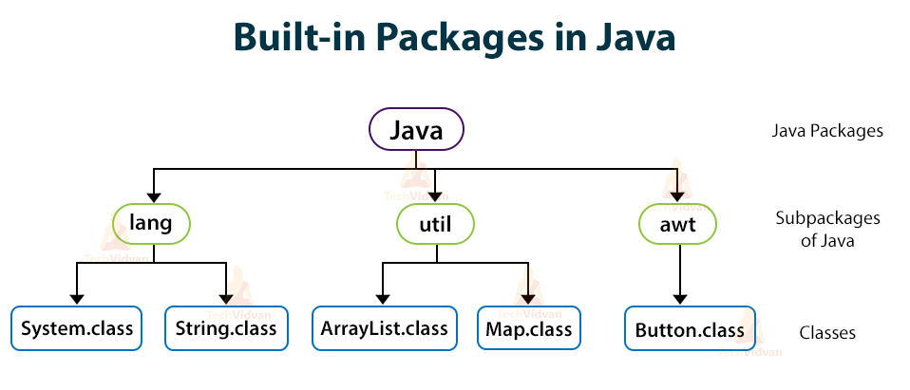
TYPES OF PACKAGES(CO3)

Slide 17
TYPES OF PACKAGES(CO3)
2. Java API packages or built-in packages
Java provides a large number of classes grouped into different packages based on a particular functionality.
Examples:
java.lang: It contains classes for primitive types, strings, math functions, threads, and exceptions.
java.util: It contains classes such as vectors, hash tables, dates, Calendars, etc.
java.io: It has stream classes for Input/Output.
java.awt: Classes for implementing Graphical User Interface – windows, buttons, menus, etc.
java.net: Classes for networking
java. Applet: Classes for creating and implementing applets

Slide 18
TYPES OF PACKAGES(CO3)
Creating a Package in Java
To create a package, we choose a package name and to include the classes, interfaces, enumerations, etc, inside the package, we write the package with its name at the top of every source file.
There can be only one package statement in each type of file. If we do not write class, interfaces, inside any package, then they will be placed in the current default package.

Slide 19
EXAMPLE OF JAVA PACKAGE(CO3)
We can create a Java class inside a package using a package keyword.
package Mypackage.packagedemo; //package
class Example
{
public static void main(String args[])
{
System.out.println("Welcome to OOT using Java Class");
}
}
Output:
Welcome to OOT using Java Class

Slide 20
HOW DO PACKAGES IN JAVA WORK?(CO3)
The names of packages and the directory structure are closely related to each other.
For example, if a package name is university.engineering.csedept, then there are three directories- university, engineering, and csedept such that csedept is present in engineering and engineering is present in university.
The package university can be considered as a top-level package while engineering is a subpackage of university and csedept is a sub-package of engineering.

Slide 21
EXCEPTIONS IN JAVA(CO3)
DICTIONARY MEANING: Exception is an abnormal condition.
In Java, an exception is an event that disrupts the normal flow of the program. It is an object which is thrown at runtime.
WHAT IS AN EXCEPTION HANDLING?
Exception Handling is a mechanism to handle runtime errors such as ClassNotFoundException, IOException, SQLException, RemoteException, etc.

Slide 22
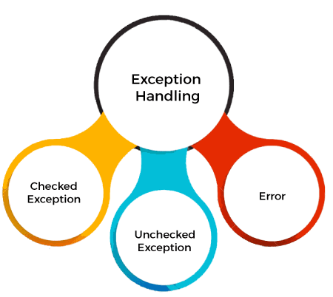
TYPES OF JAVA EXCEPTIONS(CO3)
There are mainly two types of exceptions: checked and unchecked.
An error is considered as the unchecked exception.
However, according to Oracle, there are three types of exceptions namely:
Checked Exception
Unchecked Exception
Error

Slide 23
DIFFERENCE BETWEEN CHECKED AND UNCHECKED EXCEPTIONS(CO3)
Checked Exception
The classes that directly inherit the Throwable class except RuntimeException and Error are known as checked exceptions. For example, IOException, SQLException, etc. Checked exceptions are checked at compile-time.
2. Unchecked Exception
The classes that inherit the RuntimeException are known as unchecked exceptions.
For example, ArithmeticException, NullPointerException, ArrayIndexOutOfBoundsException, etc. Unchecked exceptions are not checked at compile-time, but they are checked at runtime.
3. Error
Error is irrecoverable. Some example of errors are OutOfMemoryError, VirtualMachineError, AssertionError etc.

Slide 24
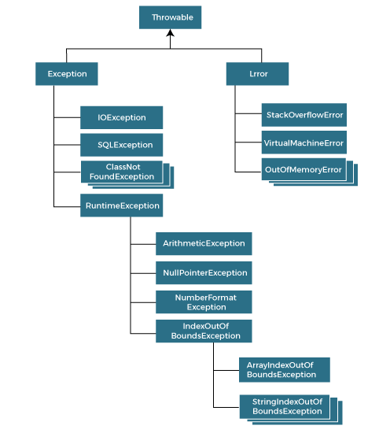
HIERARCHY OF JAVA EXCEPTION CLASSES(CO3)

Slide 25
JAVA EXCEPTION KEYWORDS(CO3)
Keyword | Description
try | The "try" keyword is used to specify a block where we should place an exception code. It means we can't use try block alone. The try block must be followed by either catch or finally.
catch | The "catch" block is used to handle the exception. It must be preceded by try block which means we can't use catch block alone. It can be followed by finally block later.
finally | The "finally" block is used to execute the necessary code of the program. It is executed whether an exception is handled or not.
throw | The "throw" keyword is used to throw an exception.
throws | The "throws" keyword is used to declare exceptions. It specifies that there may occur an exception in the method. It doesn't throw an exception. It is always used with method signature.

Slide 26
TRY-CATCH BLOCK(CO3)
Java try block is used to enclose the code that might throw an exception. It must be used within the method.
If an exception occurs at the particular statement in the try block, the rest of the block code will not execute. So, it is recommended not to keep the code in try block that will not throw an exception.
Java try block must be followed by either catch or finally block.

Slide 27
(CO3)
SYNTAX OF TRY-CATCH BLOCK
try{
//code that may throw an exception
}catch(Exception_class_Name ref){}
SYNTAX OF TRY-FINALLY BLOCK
try{
//code that may throw an exception
}finally{}

Slide 28
CATCH BLOCK(CO3)
Java catch block is used to handle the Exception by declaring the type of exception within the parameter. The declared exception must be the parent class exception ( i.e., Exception) or the generated exception type. However, the good approach is to declare the generated type of exception.
The catch block must be used after the try block only. You can use multiple catch block with a single try block.

Slide 29
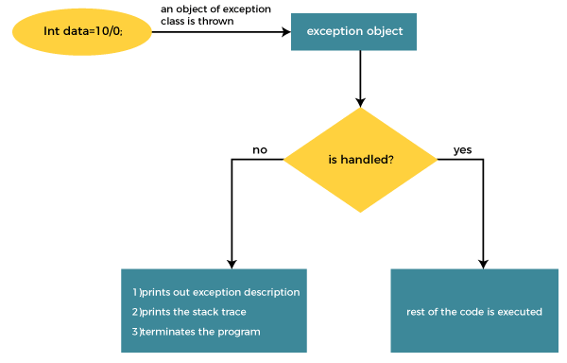
INTERNAL WORKING OF JAVA TRY-CATCH BLOCK(CO3)

Slide 30
INTERNAL WORKING OF JAVA TRY-CATCH BLOCK(CO3)
The JVM firstly checks whether the exception is handled or not. If exception is not handled, JVM provides a default exception handler that performs the following tasks:
Prints out exception description.
Prints the stack trace (Hierarchy of methods where the exception occurred).
Causes the program to terminate.
But if the application programmer handles the exception, the normal flow of the application is maintained, i.e., rest of the code is executed.

Slide 31
NESTED TRY BLOCK(CO3)
In Java, using a try block inside another try block is permitted. It is called as nested try block. Every statement that we enter a statement in try block, context of that exception is pushed onto the stack.
For example, the inner try block can be used to handle ArrayIndexOutOfBoundsException while the outer try block can handle the ArithemeticException (division by zero).
Why use nested try block?
Sometimes a situation may arise where a part of a block may cause one error and the entire block itself may cause another error. In such cases, exception handlers have to be nested.

Slide 32
SYNTAX OF NESTED TRY-CATCH BLOCK(CO3)
try // Outer try block
{
statements;
statements;
try // Inner try block
{
statements;
statements;
}
catch(Exception1 e1) // Inner catch block
{
statements;
statements;
}
}
catch(Exception2 e2) // Outer catch block
{
statements;
statements;
}

Slide 33
FINALLY BLOCK(CO3)
Java finally block is a block used to execute important code such as closing the connection, etc.
Java finally block is always executed whether an exception is handled or not. Therefore, it contains all the necessary statements that need to be printed regardless of the exception occurs or not.
The finally block follows the try-catch block.
Why use Java finally block?
finally block in Java can be used to put "cleanup" code such as closing a file, closing connection, etc.
The important statements to be printed can be placed in the finally block.

Slide 34
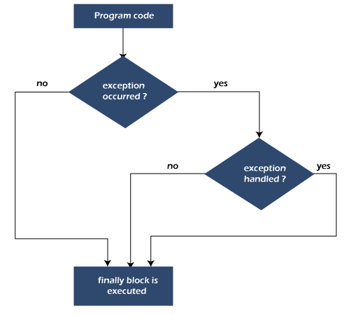
FLOWCHART OF FINALLY BLOCK(CO3)

Slide 35
THROW KEYWORD(CO3)
The Java throw keyword is used to throw an exception explicitly.
We specify the exception object which is to be thrown. The Exception has some message with it that provides the error description. These exceptions may be related to user inputs, server, etc.
We can throw either checked or unchecked exceptions in Java by throw keyword. It is mainly used to throw a custom exception. We will discuss custom exceptions later in this section.
We can also define our own set of conditions and throw an exception explicitly using throw keyword. For example, we can throw ArithmeticException if we divide a number by another number. Here, we just need to set the condition and throw exception using throw keyword.
The syntax of the Java throw keyword is given below.
throw new exception_class("error message");

Slide 36
THROWS KEYWORD(CO3)
The Java throws keyword is used to declare an exception. It gives an information to the programmer that there may occur an exception. So, it is better for the programmer to provide the exception handling code so that the normal flow of the program can be maintained.
Exception Handling is mainly used to handle the checked exceptions. If there occurs any unchecked exception such as NullPointerException, it is programmers' fault that he is not checking the code before it being used.
Syntax of Java throws
return_type method_name() throws exception_class_name{
//method code
}

Slide 37
ASSERTIONS IN JAVA(CO3)
An assertion allows testing the correctness of any assumptions that have been made in the program.
Assertion is achieved using the assert statement in Java. While executing assertion, it is believed to be true. If it fails, JVM throws an error named AssertionError. It is mainly used for testing purposes during development.
The assert statement is used with a Boolean expression and can be written in two different ways.
First way :
assert expression;
Second way :
assert expression1 : expression2;

Slide 38
Why to use Assertions?(CO3)
Wherever a programmer wants to see if his/her assumptions are wrong or not.
To make sure that an unreachable looking code is actually unreachable.
To make sure that assumptions written in comments are right
if ((x & 1) == 1)
{ }
else // x must be even
{ assert (x % 2 == 0); }
To make sure default switch case is not reached.
To check object’s state.
In the beginning of the method
After method invocation.

Slide 39
USAGE OF ASSERTIONS (CO3)
Where to use Assertions
Arguments to private methods. Private arguments are provided by developer’s code only and developer may want to check his/her assumptions about arguments.
Conditional cases.
Conditions at the beginning of any method.
Where not to use Assertions
Assertions should not be used to replace error messages
Assertions should not be used to check arguments in the public methods as they may be provided by user. Error handling should be used to handle errors provided by user.
Assertions should not be used on command line arguments.

Slide 40
LOCALIZATION(CO3)
Localization is also abbreviated as I10N because there are total 10 characters between the first letter 'L' and last letter 'N'. Localization is the mechanism to create such an application that can be adapted to a specific language and region by adding locale-specific text and component.
There are three constructors of Locale class. They are as follows:
Locale(String language)
Locale(String language, String country)
Locale(String language, String country, String variant)

Slide 41
LOCALIZATION(CO3)
There are given commonly used methods of Locale class.
public static Locale getDefault() it returns the instance of current Locale
public static Locale[] getAvailableLocales() it returns an array of available locales.
public String getDisplayCountry() it returns the country name of this locale object.
public String getDisplayLanguage() it returns the language name of this locale object.
public String getDisplayVariant() it returns the variant code for this locale object.
public String getISO3Country() it returns the three letter abbreviation for the current locale's country.
public String getISO3Language() it returns the three letter abbreviation for the current locale's language.

Slide 42
STRING HANDLING(CO3)
In Java, string is basically an object that represents sequence of char values. An array of characters works same as Java string.
char[] ch={'j','a','v','a','t','p','o','i','n','t'};
String s=new String(ch);
is same as:
String s="javatpoint";
Generally, String is a sequence of characters. But in Java, string is an object that represents a sequence of characters. The java.lang.String class is used to create a string object.

Slide 43
HOW TO CREATE A STRING OBJECT?(CO3)
There are two ways to create String object:
By string literal
By new keyword
String Literal
Java String literal is created by using double quotes.
For Example: String s="welcome";
Each time you create a string literal, the JVM checks the "string constant pool" first. If the string already exists in the pool, a reference to the pooled instance is returned. If the string doesn't exist in the pool, a new string instance is created and placed in the pool. For example:
String s1="Welcome";
String s2="Welcome";//It doesn't create a new instance

Slide 44
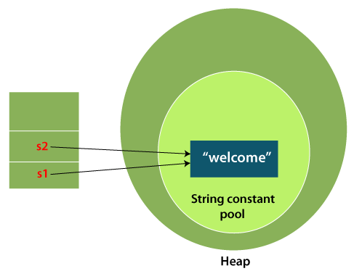
EXAMPLE(CO3)
In the above example, only one object will be created. Firstly, JVM will not find any string object with the value "Welcome" in string constant pool that is why it will create a new object. After that it will find the string with the value "Welcome" in the pool, it will not create a new object but will return the reference to the same instance.

Slide 45
HOW TO CREATE A STRING OBJECT?((CO3)
By new keyword
String s=new String("Welcome");//creates two objects and one
reference variable
In such case, JVM will create a new string object in normal (non-pool) heap memory, and the literal "Welcome" will be placed in the string constant pool. The variable s will refer to the object in a heap (non-pool).

Slide 46
IMMUTABLE STRING IN JAVA(CO3)
A String is an unavoidable type of variable while writing any application program. String references are used to store various attributes like username, password, etc. In Java, String objects are immutable. Immutable simply means unmodifiable or unchangeable.
Once String object is created its data or state can't be changed but a new String object is created.

Slide 47
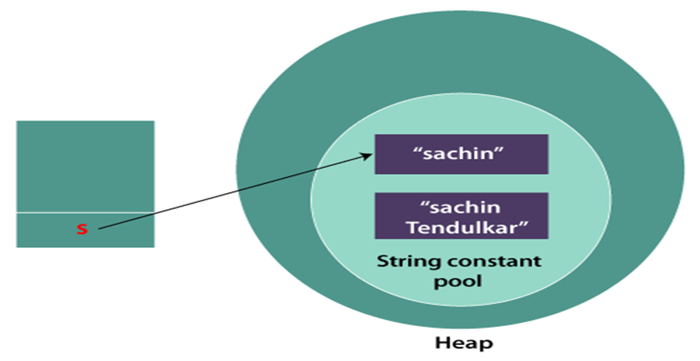
EXAMPLE(CO3)
Now it can be understood by the diagram given below. Here Sachin is not changed but a new object is created with Sachin Tendulkar. That is why String is known as immutable.
As you can see in the above figure that two objects are created but s reference variable still refers to "Sachin" not to "Sachin Tendulkar".
But if we explicitly assign it to the reference variable, it will refer to "Sachin Tendulkar" object.

Slide 48
STRING CLASS METHODS(CO3)
The java.lang.String class provides a lot of built-in methods that are used to manipulate string in Java. By the help of these methods, we can perform operations on String objects such as trimming, concatenating, converting, comparing, replacing strings etc.
String toUpperCase() and toLowerCase() method
The Java String toUpperCase() method converts this String into uppercase letter and String toLowerCase() method into lowercase letter.

Slide 49
OOA:2Application Analysis (CO3)
2. String trim() method
The String class trim() method eliminates white spaces before and after the String.
3. String startsWith() and endsWith() method
The method startsWith() checks whether the String starts with the letters passed as arguments and endsWith() method checks whether the String ends with the letters passed as arguments.
4. String charAt() Method
The String class charAt() method returns a character at specified index.
5. String length() Method
The String class length() method returns length of the specified String.

Slide 50
OOA:2Application Analysis (CO3)
6. String valueOf() Method
The String class valueOf() method coverts given type such as int, long, float, double, boolean, char and char array into String.
7. String replace() Method
The String class replace() method replaces all occurrence of first sequence of character with second sequence of character.

Slide 51
STRINGBUFFER CLASS(CO3)
Java StringBuffer class is used to create mutable (modifiable) String objects. The StringBuffer class in Java is the same as String class except it is mutable i.e. it can be changed.
Constructors of StringBuffer Class
Constructor | Description
StringBuffer() | It creates an empty String buffer with the initial capacity of 16.
StringBuffer(String str) | It creates a String buffer with the specified string..
StringBuffer(int capacity) | It creates an empty String buffer with the specified capacity as length.

Slide 52
STRINGBUILDER CLASS(CO3)
Java StringBuilder class is used to create mutable (modifiable) String. The Java StringBuilder class is same as StringBuffer class except that it is non-synchronized.
Constructors of StringBuilder class
Constructor | Description
StringBuilder() | It creates an empty String Builder with the initial capacity of 16.
StringBuilder(String str) | It creates a String Builder with the specified string.
StringBuilder(int length) | It creates an empty String Builder with the specified capacity as length.

Slide 53
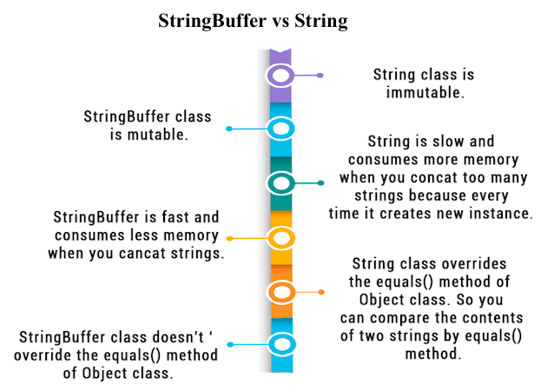
STRINGBUFFER Vs STRING(CO3)

Slide 54
Noida Institute of Engineering and Technology, Greater Noida
THANK YOU !!

Slide 55
OOA:2Application Analysis (CO3)

Slide 56
Object Oriented Design (CO3)

Slide 57
Object Oriented Design (CO3)

